Slide 1
Blueprint for Improving Instruction, Accessibility, and Outcomes for All Students
February 17th, 2015
Sacramento Convention Center

Slide 2

The Blueprint
8:30-9:00 Registration
9:00-9:15 Welcome
9:15-10:45 Laying the Foundation
10:45-11:00 Break
11:00-12:00 Building a Supportive Infrastructure
12:00-1:00 Lunch
1:00-2:15 Creating a Collaborative Educational Community
2:15-2:30 Break
2:30-4:00 Designing to Scale…Up
Notes:
Participants will reflect individually on this prompt.

Slide 3
Welcome
Dr. Fred Balcom
Director of the Special Education Division,
California Department of Education
Notes:
Participants will reflect individually on this prompt.

Slide 4
Laying the Foundation
College, Career and Civic Life Readiness for ALL Students in an Aligned System of Supports
Overview and Components
Kevin Schaefer, Asst Director of Special Programs/WestEd
District-level Panel Discussion/Panel
Facilitator:
Dr. Kristen Brown, Consultant /Special Education Division, California Department of Education
Panel:
Kimberly Salomonson, Director of Pupil Personnel Services, Sanger Unified School District
Kip Meyer, Assistant Superintendent of Personnel Services, Lake Elsinore Unified School District
Notes:
Participants will reflect individually on this prompt.

Slide 5
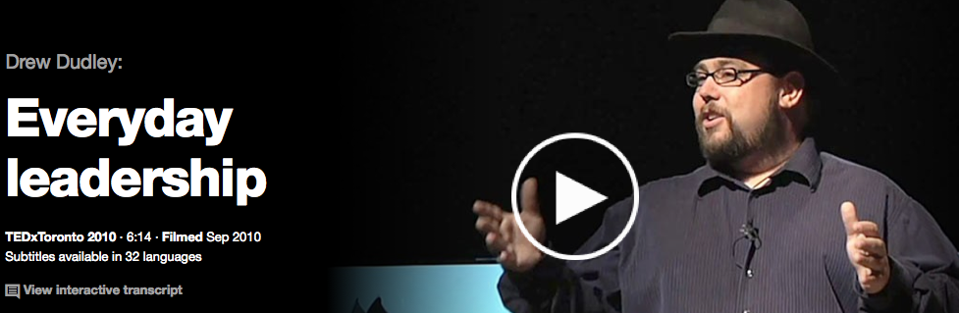
A Lollipop Moment http://www.ted.com/talks/drew_dudley_everyday_leadership
How many of you are completely comfortable with calling yourselves a leader? - Drew Dudley
Notes:
Participants will reflect individually on this prompt.

Slide 6

Why We Teach…
Why We Lead…
Simon Sinek, “Start With Why
Notes:
Participants will reflect individually on this prompt.

Slide 7
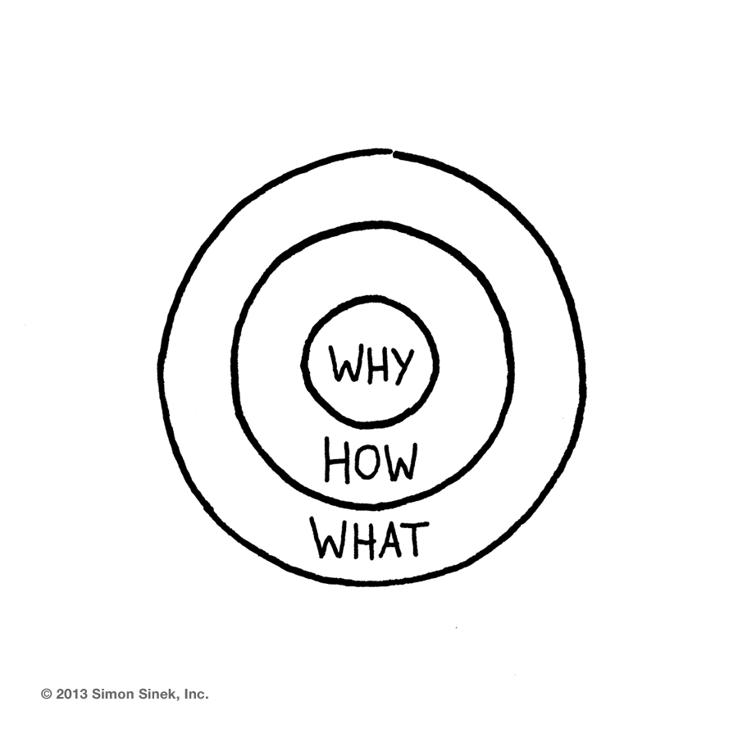
The Golden Circle
What
Every organization on the planet
knows WHAT they do. These are
products they sell or the services
they offer.
How
Some organizations
know HOW they do it. These
are the things that make
them special or set them
apart from their competition.
Why
Very few organizations know WHY
they do what they do. WHY is not
about making money. That’s a result. It’s a purpose, cause or belief. It’s the very reason your organization exists.
Notes:
Leaders and organizations with the capacity to inspire think, act and communicate from the inside-out. They start with Why. When we communicate our purpose or cause first, we communicate in a way that drives decision-making and behavior. It literally taps the part of the brain that inspires behavior.

Slide 8
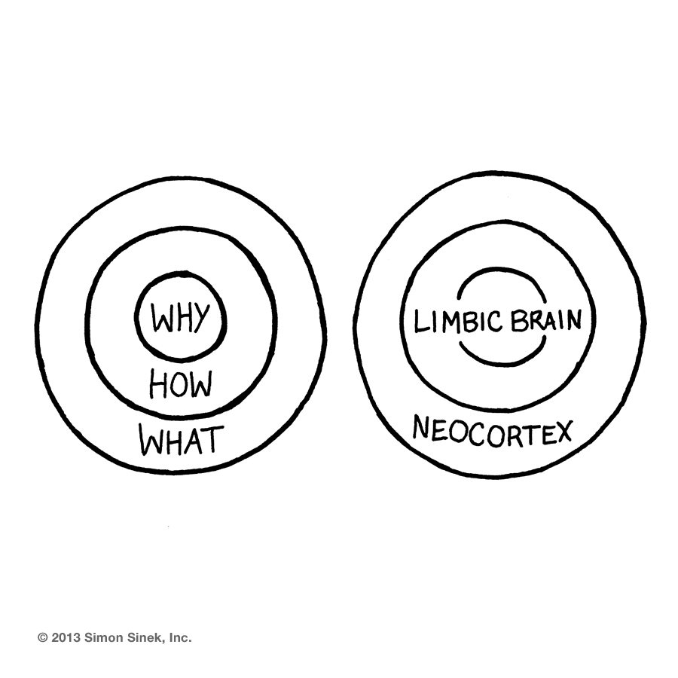
Why We Lead…
Notes:
Participants will reflect individually on this prompt.

Slide 9
What Is Your Why?
To do:
“Why I Lead.” Reflect your answer on a Post-It
Collect your team’s Post-Its in one space
(chart paper, for example)
Consensus-building:
Agree on one collective statement that would
describe the “Why” of your team.
Share:
Notes:
Participants will reflect individually on this prompt.

Slide 10
Multi-tiered System of Supports (MTSS)
A coordinated system of supports and services is crucial for ensuring appropriate and timely attention to students’ needs. The Multi-Tiered System of Supports (MTSS) model expands California’s Response to Intervention and Instruction (RtI2) process by aligning all systems of high quality first instruction, support, and intervention and including structures for building, changing, and sustaining systems. In addition, assessments and progress monitoring are employed to allow for a data-based, problem-solving approach to instructional decision-making.
-CA ELA/ELD Framework, 2014 (Chapter 9, Pages 46-47)

Slide 11
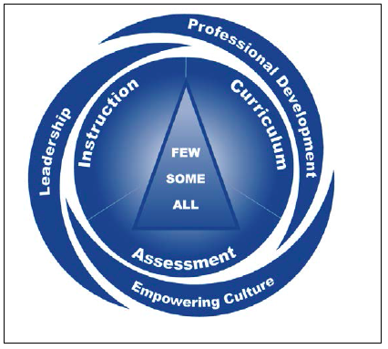
MTSS
Source: Kansas MTSS: http://www.kansasmtss.org/

Slide 12
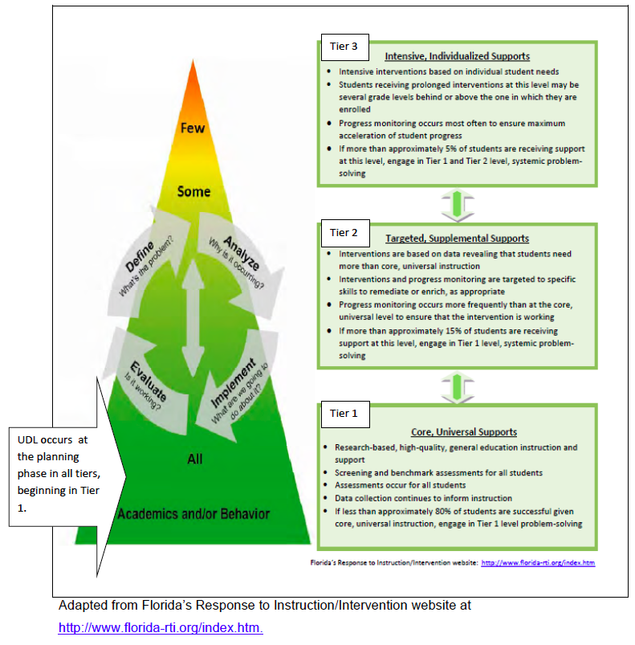

Slide 13
MTSS
Schools and districts should have in place a well-defined framework for MTSS, including a leadership and organizational structures, routines for program evaluation and progress monitoring of students, initial and ongoing professional learning for all educators, and clear two-way communication between parents and educators.
-CA ELA/ELD Framework, 2014 (Chapter 9, Page 50)

Slide 14
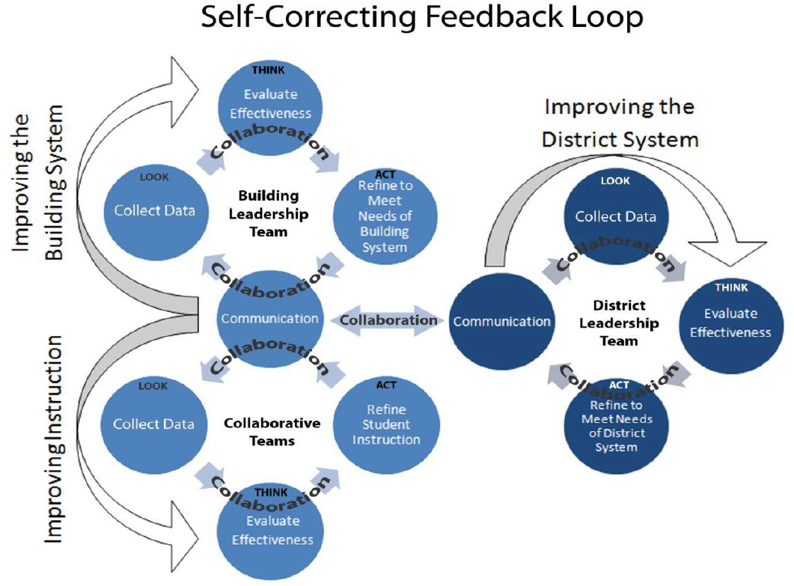
Source: Kansas MTSS: http://www.kansasmtss.org/
Notes:
A Self-Correcting Feedback Loop
The defining element of an effective MTSS is a Self-Correcting Feedback Loop, which is achieved through the use of a problem-solving process that continually collects data, analyzes results, and makes adjustments aimed at positively influencing student learning and achievement. While the term self-correcting suggests something that happens automatically, the reality is that there is nothing automatic about it. The forces behind the Self-Correcting Feedback Loop are teams working in concert toward a common vision. In order to ensure that all parts of the feedback loop are functioning, teams must utilize bi-directional communication in a clear, consistent fashion.
The cycle of Improving Instruction in the graphic represents the work of collaborative teams comprised of teachers and support staff who are in charge of analyzing data (screening, diagnostic, and progress monitoring) at the grade, classroom, small group, and individual student levels. The collaborative teams use data to group students; identify the instructional focus of the groups; ascertain the materials to be used for Core, Supplemental, and Intensive instruction; and evaluate the effectiveness of the supports being provided. Collaborative teams have the ultimate responsibility of informing the building leadership team of how the system is operating on the front lines. Members of the collaborative teams are “in the trenches,” so to speak, providing insights regarding potential system issues. Information is proactively communicated to the building leadership team for a timely, effective response.
The cycle of Improving the Building System in the graphic represents the work of the building leadership team made up of members of collaborative teams representing all grade levels, as well as other appropriate staff members. The building leadership team, led by the building principal, is responsible for making all the pieces of the system function effectively and ensuring that student learning is monitored and evaluated. To accomplish this, the building leadership team analyzes input from the collaborative teams in addition to building-level student data. The leadership team determines whether adequate progress is being made toward building goals. The team evaluates the effectiveness of components of the system to determine if adjustments are needed. When adjustments are required, the team determines what actions will be taken to refine the system. When results are not consistent with the goals, the building leadership team determines what course of action is needed to improve the system. The building leadership team, with the principal making final decisions, has the ultimate responsibility of ensuring that the system is intentionally redesigned so that each student is learning.
The graphic illustrates the intersection of these two cycles occurring at different levels for different purposes, each communicating with the other. It is at the intersection of these cycles that anticipated actions are communicated to the collaborative teams. In addition to the crucial communication between the collaborative teams and the building leadership team, communication with the district leadership team must occur. This is a reciprocal communication, as the building leadership team seeks to share information about successes as well as any need for support from the district. The district, in turn, shares district decisions that the building leadership team needs to know so that it can determine the impact to the MTSS.
The district leadership team is made up of members representing schools in the district as well as district leaders. The cycle of Improving the District System in the graphic represents the work of the district leadership team. It is the responsibility of this leadership team to ensure that the district system has all the pieces functioning effectively to support the growth of the MTSS in each building.
To accomplish this, the district leadership team analyzes district- and building-level input and data to evaluate the effectiveness of district supports. Through this analysis, district leadership teams determine if adjustments in district supports are needed and communicate what actions or resources will be provided to building leadership teams.

Slide 15
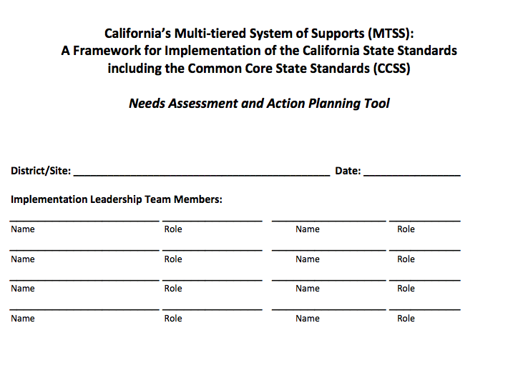
MTSS Tool

Slide 16
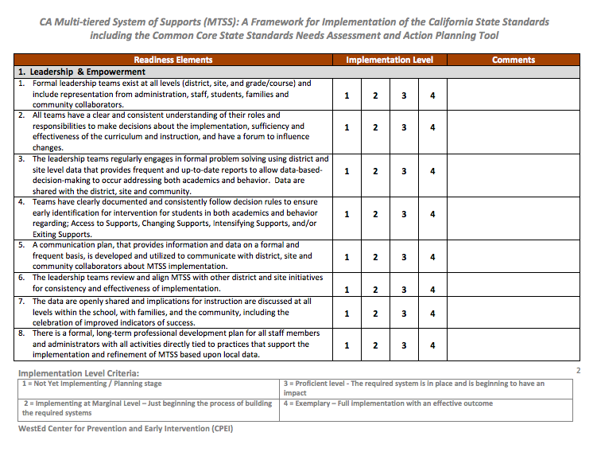
Leadership & Empowerment

Slide 17
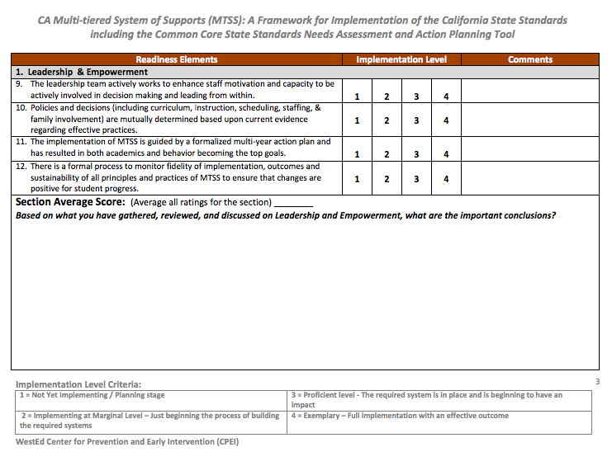
Leadership & Empowerment
(Continued)

Slide 18
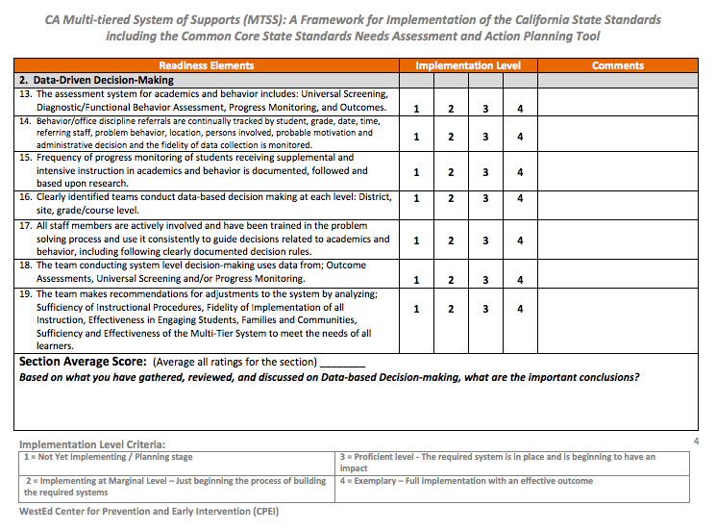
Data-Driven Decision-Making

Slide 19
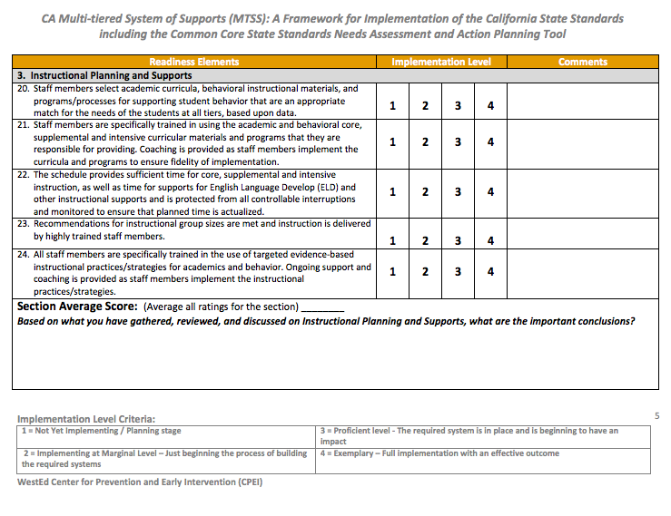
Instructional Planning and Supports

Slide 20
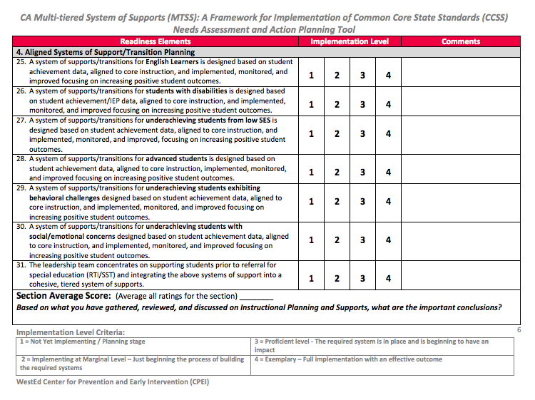
Aligned System of Supports/Transition Planning

Slide 21
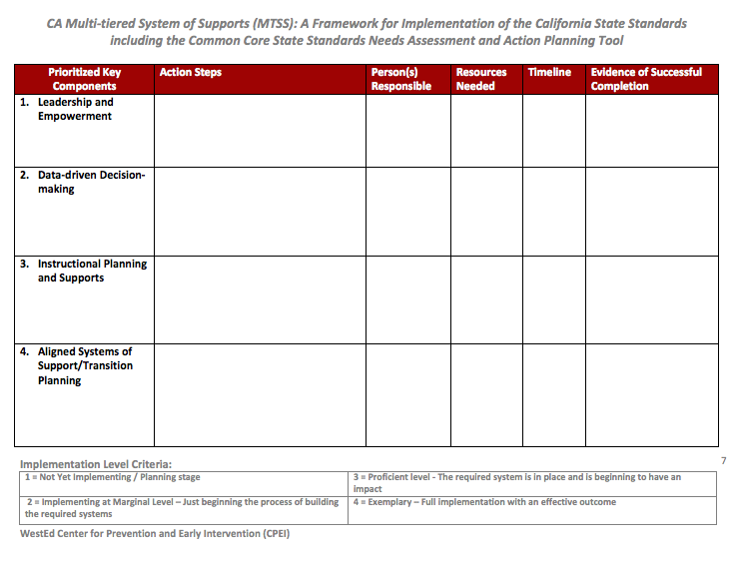
Prioritization of Key Components

Slide 22
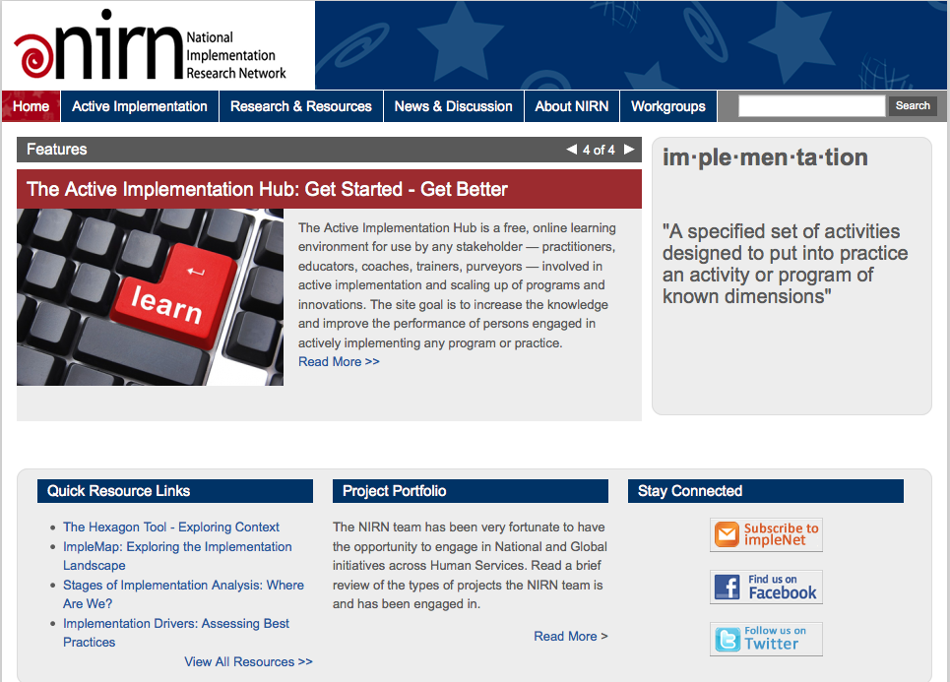
Implementation Science

Slide 23
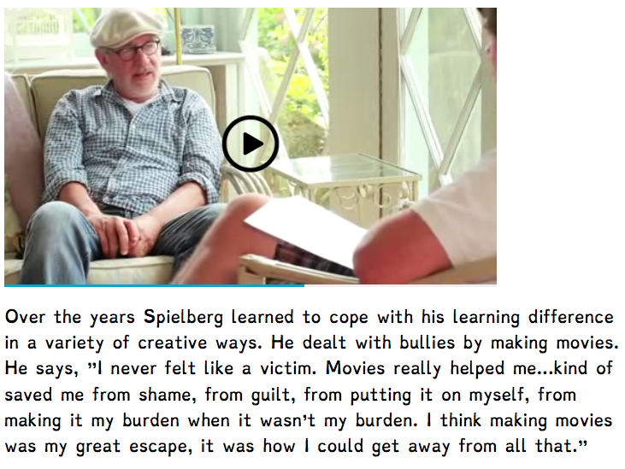
Final Thoughts... www.friendsofquinn.com
Sometimes it is the people who no one imagines anything of…who do the things that no one can imagine. Joan Clark “The Imagination Game”

